Slide 1
4COSC001W: Lecture Week 2
1. Part A
Built-in Functions - int(), float(),
Keyboard input
Pseudocode
Augmented Assignment Operators
2. Part B
Debugging, Program Errors, Try and Except

Slide 2
Built-in Functions – print()
A function is a piece of code written to carry out a specified task.
We have seen the print() function is used to send content to the screen
Python is case sensitive. Use print(), rather than Print() or PRINT().
print() # empty line
print('Hello') # Hello
print(42) # 42
greeting = 'Hello' # Assign a string to variable
print(greeting) # print variable value

Slide 3
Keyboard input - input() function
Typical flow of a simple computer program
Input data,
Work with data,
Output answer/s.
input() function - program stops and waits for the user input. When the user presses Return or Enter, the input is returned to the program as a string.
text = input()
input() can take text as an argument (e.g., a prompt stating what input is expected):
name = input('What...is your name?\n')

Slide 4
Keyboard input - input() function
Note: \n represents a newline (line break) so that any user input will appear below the prompt message.
If you expect the user to type an integer, convert the value to integer.
int() returns an integer so you need to save the result into a variable.
prompt = 'What is 38 plus 5?\n'
answer = input(prompt)
answer = int(answer)

Slide 5
Conversion functions – int(), float(), str()
int() function takes any value and converts it, if it can, to an integer:
a = int('32') # a is integer 32
b = int('Hello') # produces an error
int() function can convert floating-point values to integers, but it doesn’t round off; it chops off the fraction part:
c = int(3.99999) # c ______________
d = int(-2.3) # d ______________

Slide 6
Conversion functions – int(), float(), str()
float() function converts integers and strings to floating-point numbers:
a = float(32) # 32.0
b = float('3.14159') # 3.14159
str() function converts its argument to a string (seen earlier):
c = str(32) # '32'
d = str(3.14159) # '3.14159'

Slide 7
Pseudocode (1)
To use pseudocode, all you do is write what you want your program to do in short English phrases.
Allows you to focus on the algorithm logic without being distracted by details of language syntax.
Pseudocode is not a rigorous notation, since it is read by people. However, for consistency you can use a particular style.

Slide 8
Pseudocode (2)
SEQUENCE – linear, one task performed sequentially after another.
Common Action Keywords for input, output and processing:
Input: INPUT, READ, GET
Output: PRINT, DISPLAY, OUTPUT
Compute: COMPUTE, CALCULATE
Initialize: SET
Add one: INCREMENT

Slide 9
Pseudocode - example 1
Example 1: Calculate the average of three numbers. Example pseudocode:
INPUT num_1
INPUT num_2
INPUT num_3
average <- (num_1 + num_2 + num_3) / 3
PRINT average
Pseudocode is a set of instructions to solve a programming problem – carried out before the implementation stage.
The implementation stage involves creating the program in chosen programming language using the pseudocode for guidance.

Slide 10
Pseudocode – example 2 & 3
Example 2: Write the program to store 5 into total. Then add 1 onto total and store the answer back into total.
Pseudocode: total <- 5
total <- total + 1
Example 3: Write the program to store 5 into cost, then add 3 onto cost and store the answer back in cost.
Pseudocode : cost <- 5
cost <- cost + 3

Slide 11
Lecture Self-Check Question
Write pseudocode to put zero into variable running_total. Then write separate instructions to add the following numbers onto what is in the variable, adding one number at a time 5, 8, 2, 3. Print running_total.

Slide 12
Lecture Self-Check Question
1. Write a program to get and print the number of pets a user has.

Slide 13
Lecture Self-Check Question (Solution for Tutorial)
2. Write the Python program using the following pseudocode.
INPUT num_1
INPUT num_2
total <- num_1 + num_2
PRINT total

Slide 14
Lecture Self-Check Question (Solution for Tutorial)
3. Write the Python program using the following pseudocode.
INPUT cost_of_item
INPUT cash_paid (e.g., 10 for £10)
CALCULATE change
PRINT change

Slide 15
Lecture Self-Check Question (Solution for Tutorial)
4. Write the program to calculate the average of 3 numbers. Pseudocode:
INPUT num_1
INPUT num_2
INPUT num_3
average <- (num_1 + num_2 + num_3) / 3
PRINT average

Slide 16
Augmented Assignment Operators
Example Python code: count = count + 1
Python does not support ++ and -- operators to add/minus 1 (used in other programming languages). However, the code can be shortened: count += 1
Complete the examples:
Operator | Example | Is equivalent to
+= | x += 3 | x = x + 3
/= |  | x = x / 5
*= |  | x = x * 4
-= |  | x = x – 2

Slide 17
Lecture 2 -
Part A - covered
Built-in Functions - int(), float(), str(), input()
Pseudocode
Augmented Assignment Operators . E.g., x += 3
Intermission break – 5 mins
Part B
Debugging
Program Errors: syntax errors, runtime errors, and semantic errors.
Common error messages
Try …. Except - Python Exception Handling

Slide 18
Indentation
Over the next few weeks we create code ‘blocks’ for conditions and loops.
Indentation refers to the spaces at the beginning of a code line.
Where in other programming languages the indentation in code is for readability only, the indentation in Python is very important.
Python uses indentation to indicate a block of code. (Note: many other programming languages indicate blocks with curly braces {}).
An indentation example will be shown for the try … except concept

Slide 19
Debugging
Bug - An error in a program
Debugging - The process of finding and correcting bugs
The ability to debug your programs is an important skill!
Three kinds of errors can occur in a program:
syntax errors,
runtime errors, and
semantic errors.

Slide 20
Debugging - Syntax error
Syntax error - Refers to the structure of a program and the rules about that structure.
Look for missing parentheses, quotation marks, or commas.
E.g., parentheses have to come in matching pairs) is a syntax error
Python displays an error message and quits, and you will not be able to run the program.
It is normal when you start programming to spend a lot of time tracking down syntax errors!

Slide 21
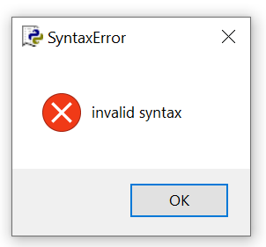
Debugging - SyntaxError
SyntaxError: Example:
current_time_str = input("Current time (in hours 0-23)?")
wait_time_str = input("How many hours until alarm?"
current_time_int = int(current_time_str)
wait_time_int = int(wait_time_str)
final_time_int = current_time_int + wait_time_int
print(final_time_int)
To find: Look for missing parentheses, quotation marks, or commas. IDLE might highlight a line of code that does not have an error. So, work back line by line until you find the syntax error.

Slide 22
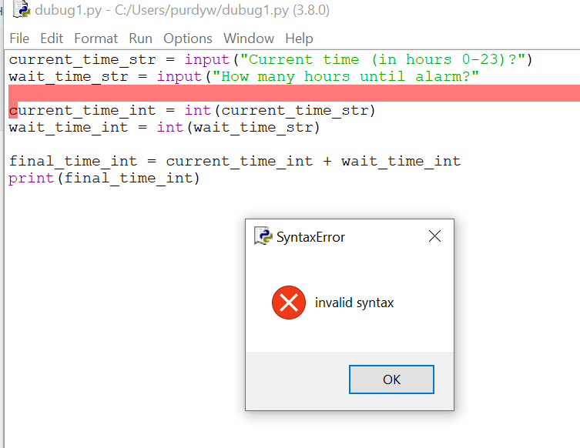

Slide 23
Debugging – Runtime & Semantic Errors
Runtime error
The error does not appear until after the program has started running. Also called exceptions (e.g., something exceptional has happened).
We will look at some errors related to exceptions:
NameError, TypeError, ValueError, ZeroDivisionError
Semantic error
Semantics – the meaning of a program.
Semantic error - An error in a program that makes it do something other than what the programmer intended.
The program will run without generating error messages, but it will not do the right thing.

Slide 24
Debugging
Debugging can involve finding clues.
Error Messages - Understanding error messages can help you.
Using print to debug your code - Using extra print() statements to display the value of your program's variables is a useful way to figure out what’s is really going on in your program
Note that sometimes an error message is caused by something that has happened earlier in the program so you might need to work backwards (up) from the error.

Slide 25
Debugging - TypeError
TypeError: often when an expression tries to combine two types that are not compatible (e.g., integer and string).
Example:
a = int(input('Enter number '))
x = input('Enter another number ')
total = a + x
Output:
Enter number 56
Enter another number 45
Traceback (most recent call last):
File "C:/Users/purdyw/test2.py", line 3, in <module>
total = a + x
TypeError: can only concatenate str (not "int") to str
>>>

Slide 26
Debugging – TypeError (continued)
Previous Example:
a = int(input('Enter number '))
x = input('Enter another number ')
total = a + x
To find: trace through variables to check they are the type you expected using type(). Adding the following after line 2:
print(type(a)) # <class 'int'>
print(type(x)) # <class 'str'>

Slide 27
Debugging - NameError
NameError: usually means you have used a variable before it has a value. Typo?
Example: NameError: name 'wait_time_int' is not defined
current_time_str = input("Current time (in hours 0-23)?")
current_time_int = int(current_time_str)
wait_time_str = input("How many hours do you want to wait")
wait_time_int = int(wait_time_int)
final_time_int = current_time_int + wait_time_int
print(final_time_int)
To find: Check the right hand side of assignment statements. You could also search for the exact word highlighted in the error message

Slide 28
Debugging - ValueError
ValueError: Raised when an operation or function receives an argument that has the right type but an inappropriate value
Example:
We ask the user for a number and instead they enter a character t.
We use int() to convert user input (string) to an integer but the value t cannot be converted to an integer number.
ValueError: invalid literal for int()
a = input('Enter number ')
a = int(a)
# do something here
# print result
To fix: use try / except to catch this error.

Slide 29
Debugging - ZeroDivisionError
ZeroDivisionError: with Python it is not possible to divide numbers by zero.
If you attempt to divide by 0, python will throw a ZeroDivisionError
x = 100/0
To fix:
Use an if statement to ensure that the value is not zero.
Or use try / except to catch this error (example later)

Slide 30
Exception Handling in Python
What happens if a program is processing user input and the user enters the wrong type of data? The ‘try/except’ construct can prevent the program crashing with an error.
Exception: An error that occurs at runtime. Handle an exception by wrapping the block of code in a try . . . except construct. Syntax:
try:
Python commands
except:
Exception handler

Slide 31
Exception Handling in Python – Example
a = "1"
try:
b = a + 2
except:
print(a, " is not a number")
We try to add a number and a string (generates an exception). We trap the exception let the user know instead of letting the program crash.
The above does not specify a specific exception (error) to handle, so can be used for any errors that occur while executing these commands.

Slide 32
Exception Handling - ValueError
An exception for a specific exception (error). Syntax:
try:
Python commands
except ExceptionType:
Exception handle
E.g., if input cannot be cast to an int it will generate a ValueError.
try:
n = int(input("Please enter an integer: "))
except ValueError:
print("Requires a valid integer!")

Slide 33
Exception Handling – ZeroDivisionError
An exception for a specific exception (error). Syntax:
try:
Python commands
except ExceptionType:
Exception handle
E.g., attempting to divide by zero will cause a ZeroDivisionError.
try:
x = 2 / 0
except ZeroDivisionError:
print("Cannot divide by zero!")

Slide 34
End Slide
Part B covered:
Debugging
Program Errors:
syntax errors,
runtime errors, and
semantic errors.
Common error messages
Try and Except - Python Exception Handling

